Slide 1
Enabling Live Data Reduction in Mantid
Presented to
SNS/ESS Workshop on Opportunities for Accelerating Neutron Data Analysis
Stuart Campbell Neutron Data Analysis & Visualization Neutron Science Directorate
June 28, 2012

Slide 2
Why Bother ?
Monitoring experiment
Raw data (e.g. monitor plots, alignment scans, etc…)
Reduced data (e.g. S(Q,ω), etc…)
Experimental steering
Provide user with more information to make better use of beam time
Automatic feedback to Data Acquisition System

Slide 3
Why Use Mantid?
Standard framework for data reduction
Event aware
Provides visualisation tools
(plots update automatically)
Easily to customize and extend.
Notes:
Plots update automatically

Slide 4
Data Flow
Listener reads from stream
Process Data ‘Chunk’
Accumulate into workspace
Do Post Processing (if required)
Update Output Workspace

Slide 5
Listener
Output workspace
Processing
Event Buffer
Algorithm
Load Live Data
Post Process
NO
Python
YES
Post Processing
Algorithm
Output workspace
Accumulation workspace
Python
Notes:
Listener design separates facility and DAS specific code in one plugin replaceable location

Slide 6
Live Listener Plugins
SNS – event Listener for SMS
Choose starting point (now, start of current run or a specified time)
ISIS Histogram Listener
ISIS Event Listener (to be developed)
Dummy Listeners for testing/development
Random Events
Replay historic data (neutron event files)

Slide 7
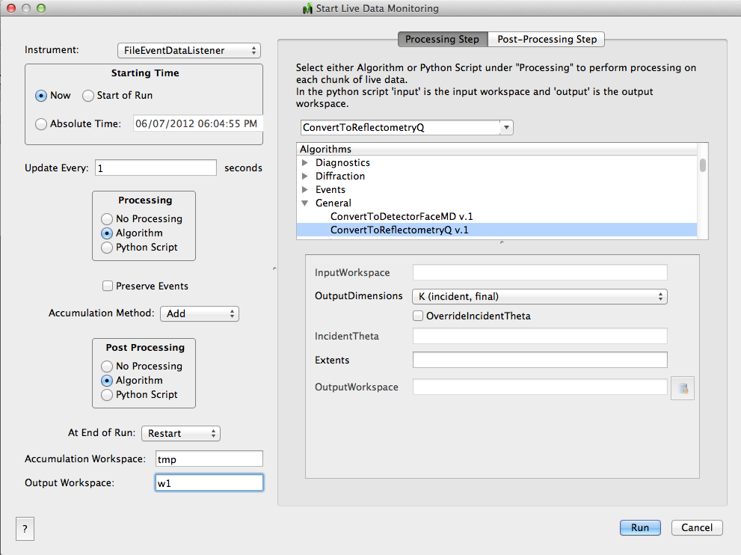
Notes:
Can handle change over between runs

Slide 8
Demo – BASIS S(Q,ω)

Slide 9
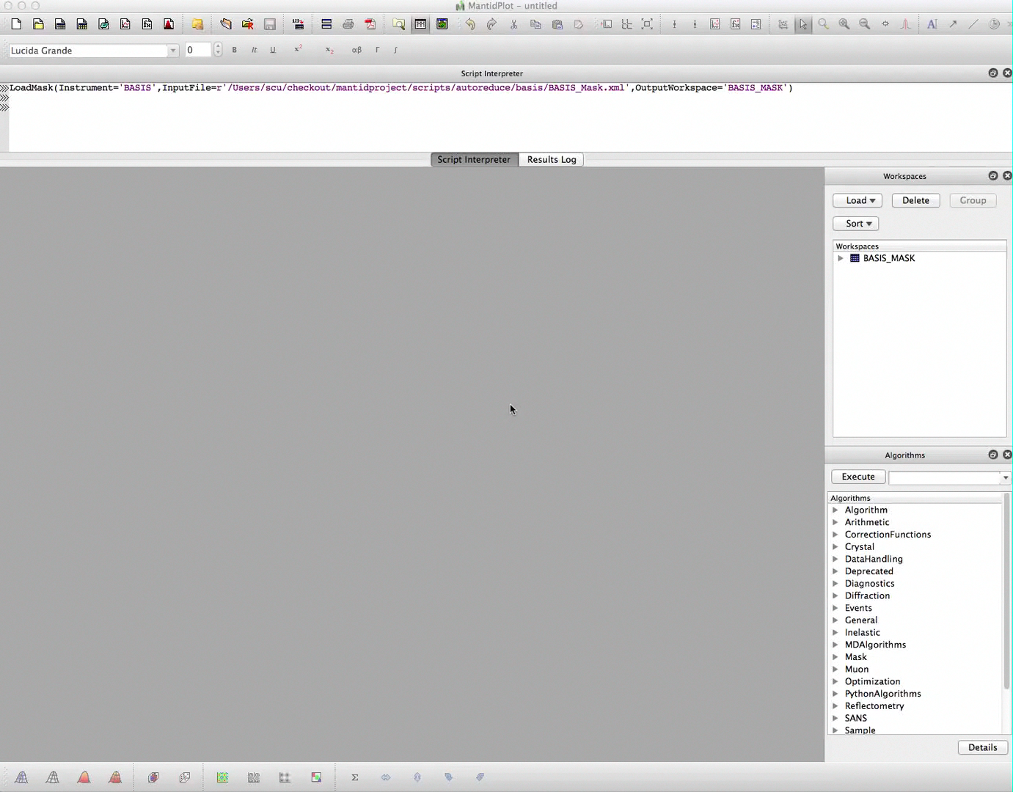
Notes:
Video showing basis data replay
…process (python script) -> I(angle, w)
…post process to S(Q,w)
Showing updating plot, multiplot, slice viewer (live cut)

